Slide 1
TRANSPORT MAP PROVIDER NEON
INDEX NUMBERS | NAME WITH INITIALS
165083B | T.TAMILCHELVAN
165032U | KIRISHANTHI.S
165071L | SEMAPALA G.D.C.H
165069M | SANDEEPANI U.G.S
165087P | THARMI.V

Slide 2
Overview of the presentation
Introduction
Other’s work
Aim and Objectives
Our approach
Design
Implementation
Further work

Slide 3
Introduction
The objective of this work is to present an efficient transport service for passengers and drivers. It is argued that there is no scheduled time table for bus service. This will provide the solution by predicting the arrival time and also this provides facilities for connecting the passengers and drivers.

Slide 4
Other's work
In Sri Lanka, nowadays UBER, Pick Me are working based on graphical information real time location but they provide their service for small scale vehicles but, we are going to implement our system for public and private bus service.
Our project is concerned with providing scheduled bus time table for passengers.

Slide 5
Aim and Objectives
Aim
Enhance the efficiency of the transportation process by enhancing the interaction between passengers and drivers.
Objectives
To provide a proper scheduled time table for the bus service.
To provide prediction of arrival time for a particular bus.
To provide a platform to connect passenger and drivers.

Slide 6
To provide a system for the passengers to search the location of a particular bus and get the location of the bus.
To allow the user to make the rating for the drivers and give feedback.
To provide the drivers with their feedback they gain from passengers.
To provide drivers their activity graph on their service with time in week wise
To provide newsfeed to the passengers

Slide 7
Our Approach
Users : Passengers, Drivers
Inputs :Route details, Real time location, Feedback, Posts
Outputs : Prediction of arrival time, Bus location, Review, Activity graph, Newsfeed
Technology : Android Studio, Matplot python library, Node js, Bootstrap, jQuery,Firebase

Slide 8
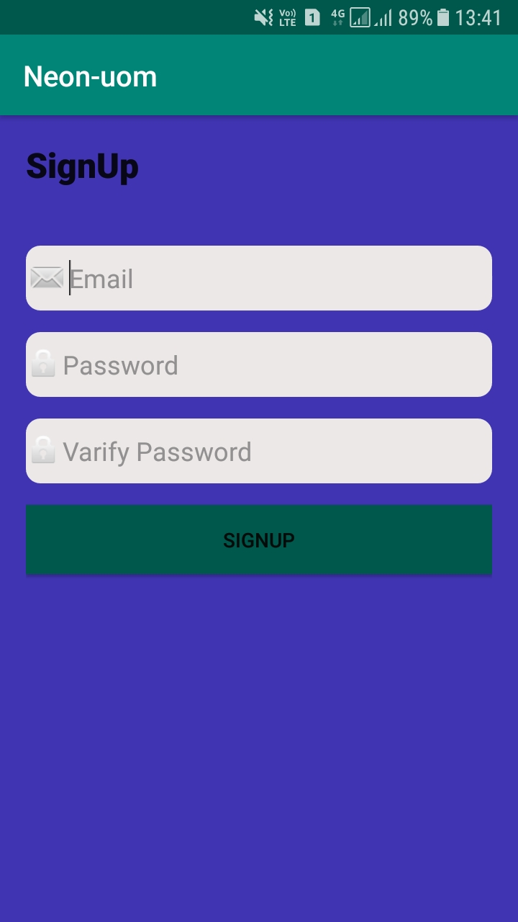
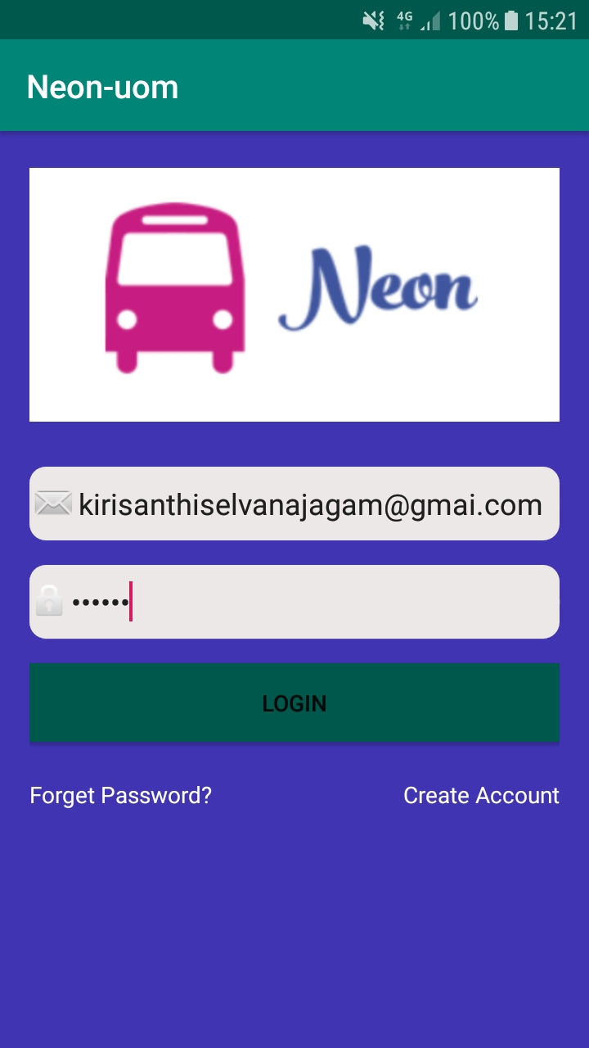
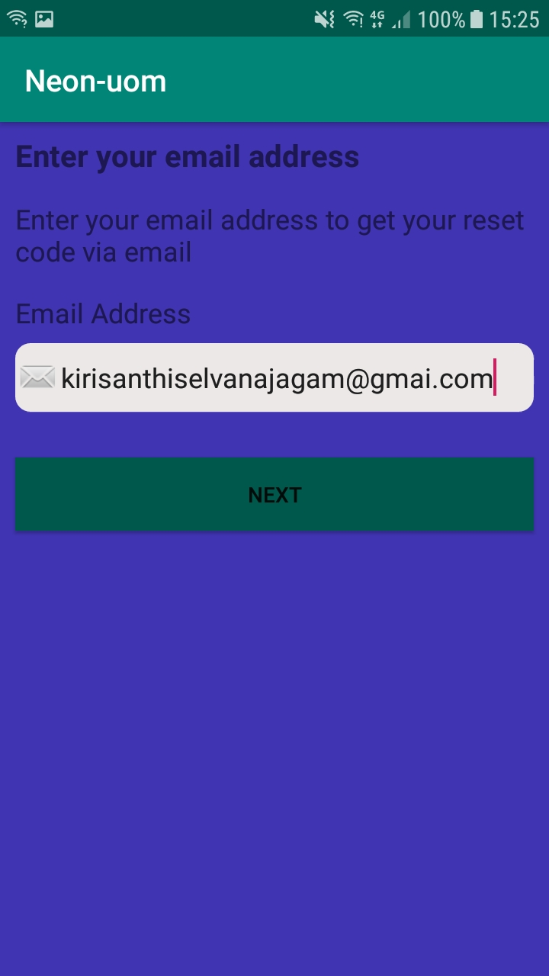
Implementation
Android app UI

Slide 9
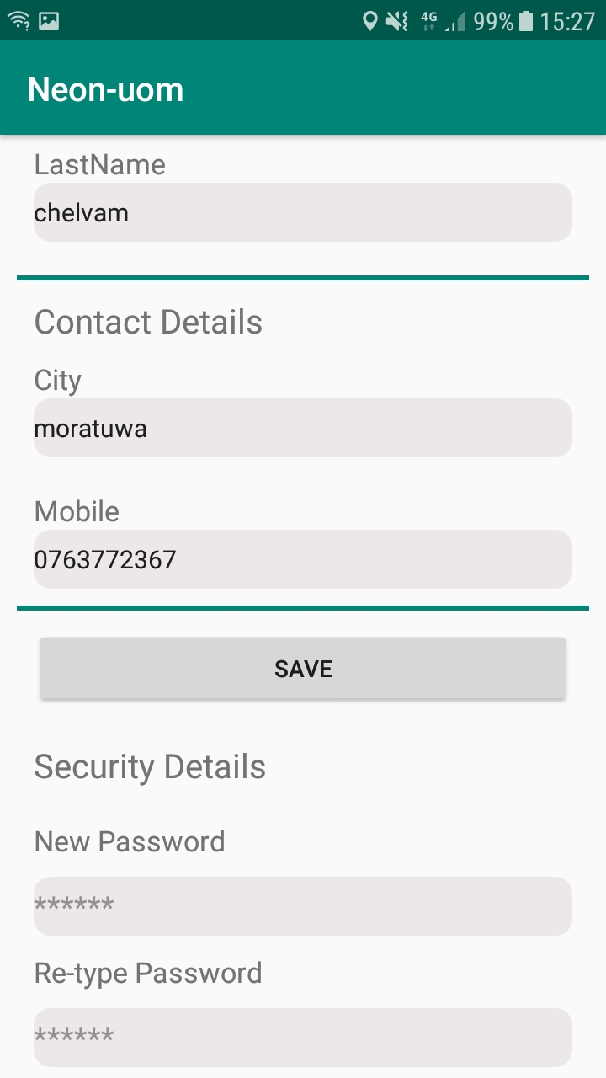
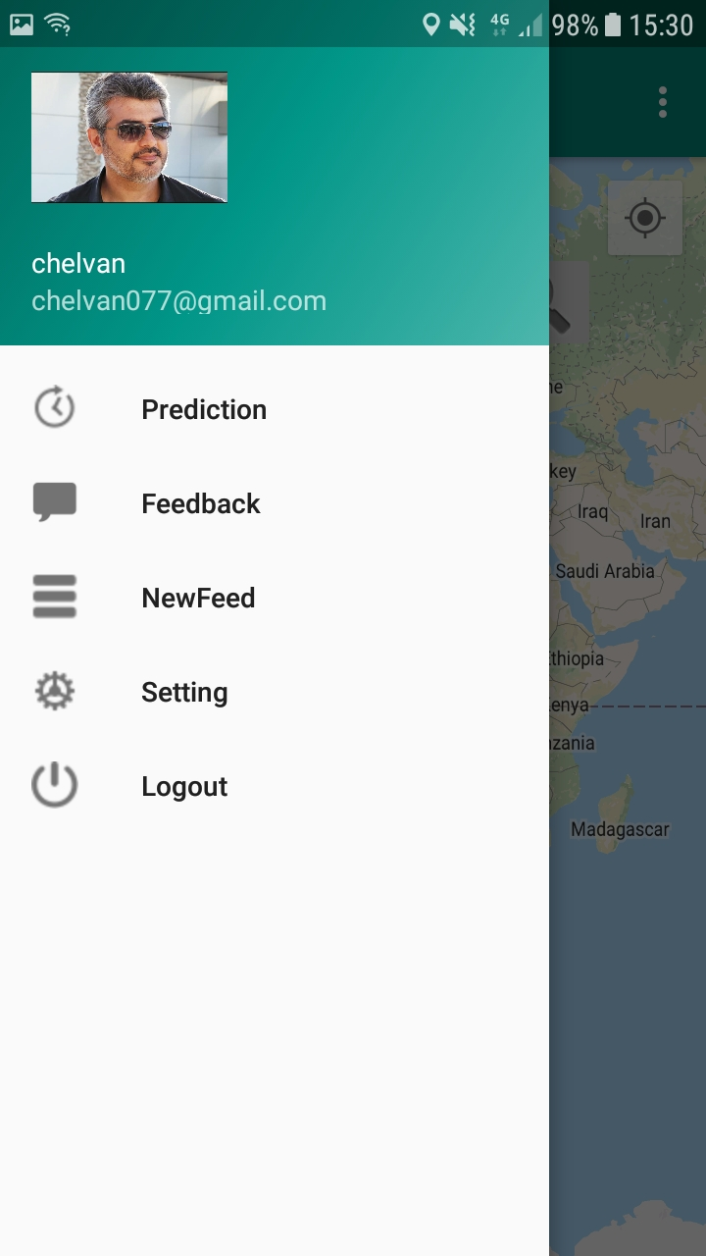
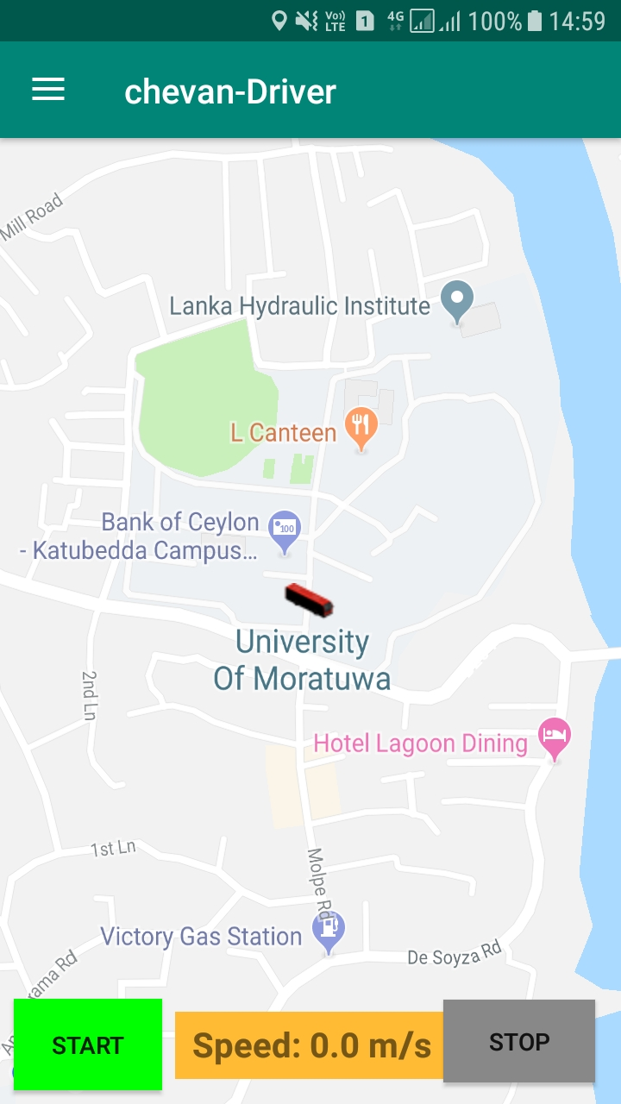

Slide 10
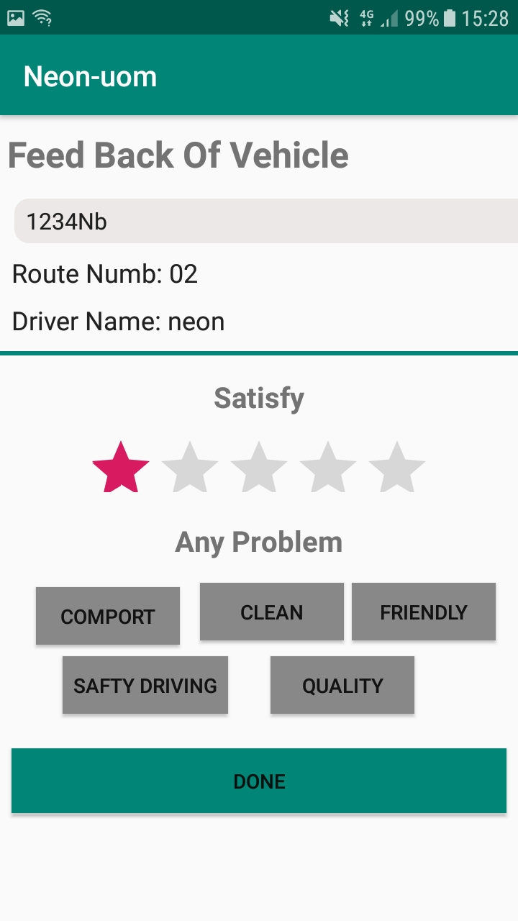
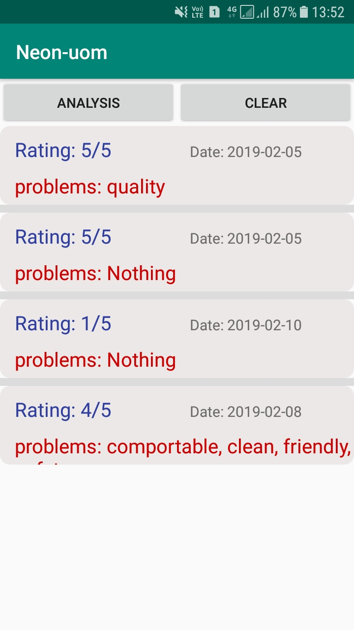
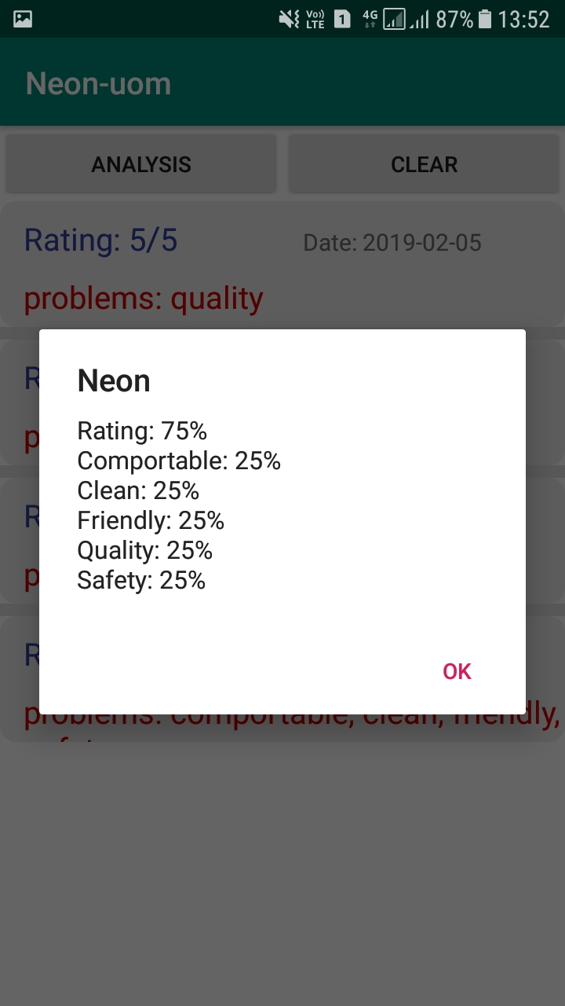

Slide 11
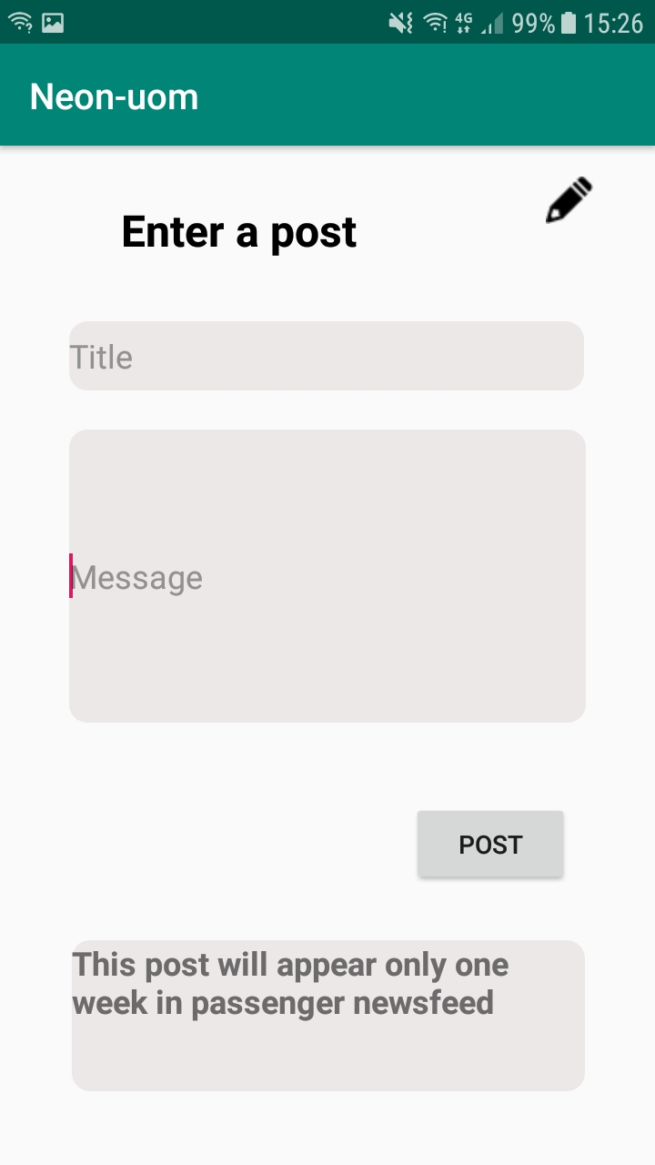
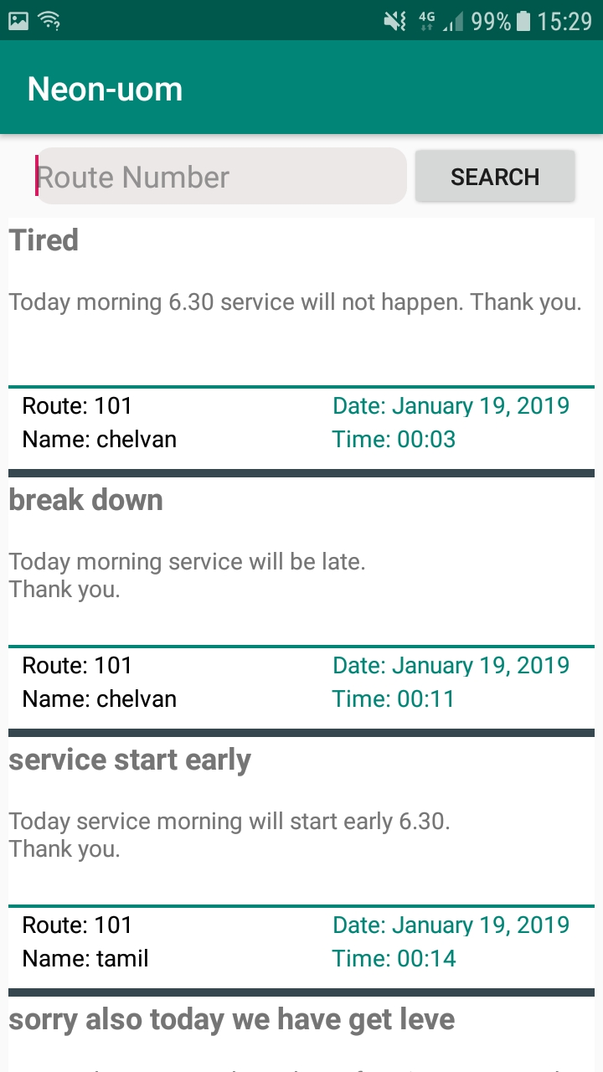
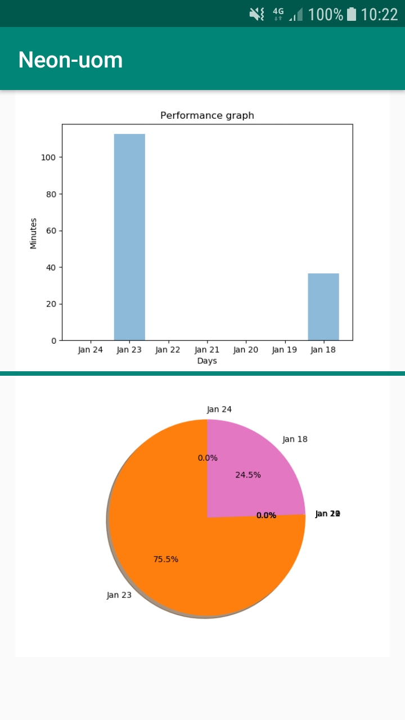

Slide 12
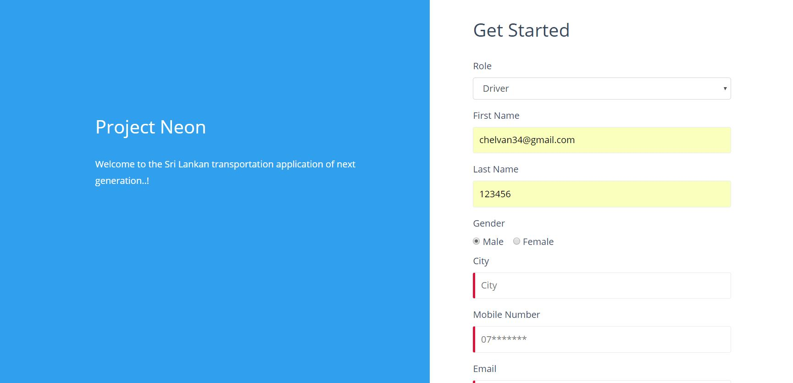

Slide 13
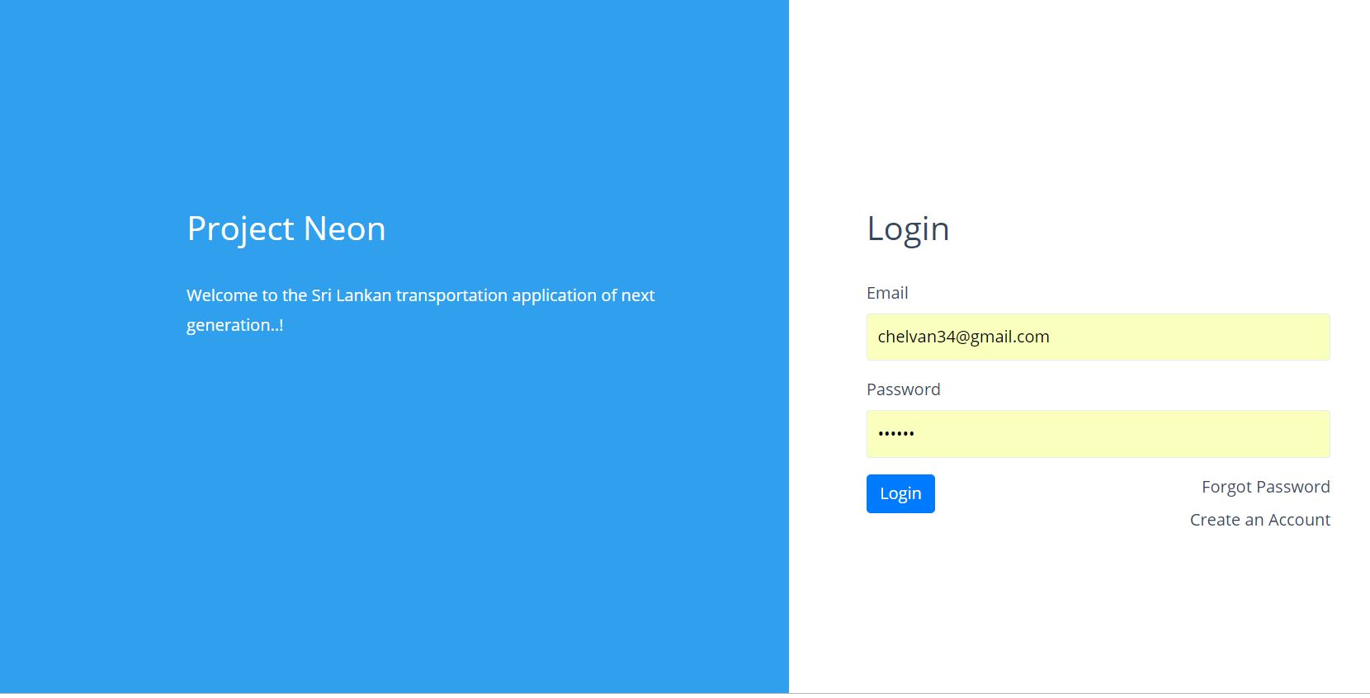

Slide 14
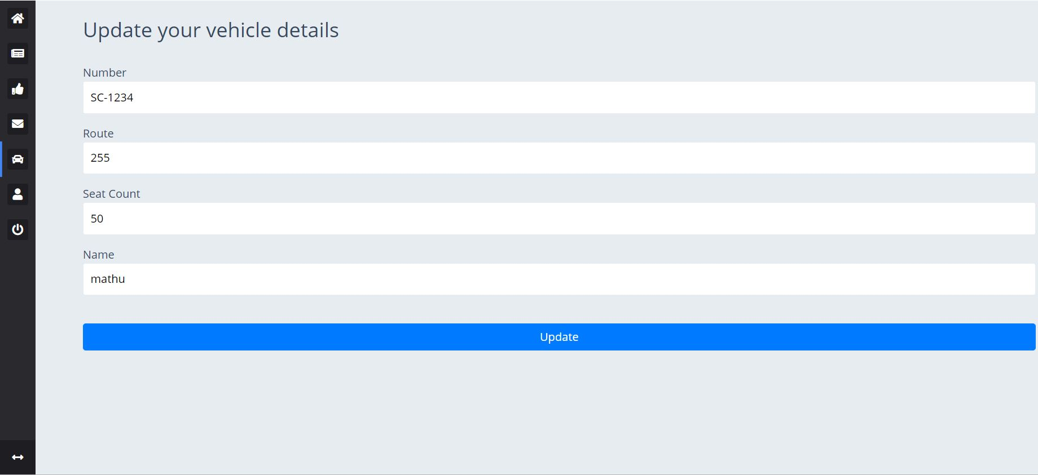

Slide 15
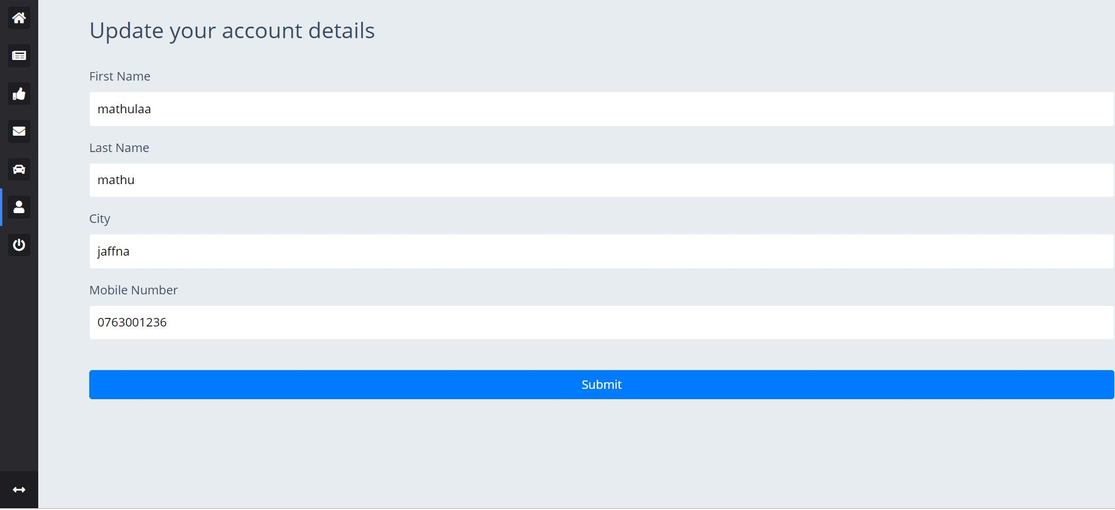

Slide 16
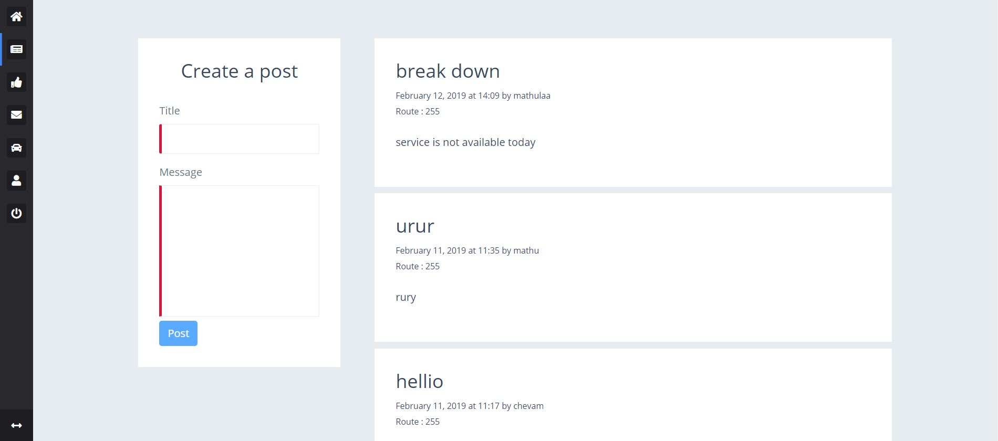

Slide 17
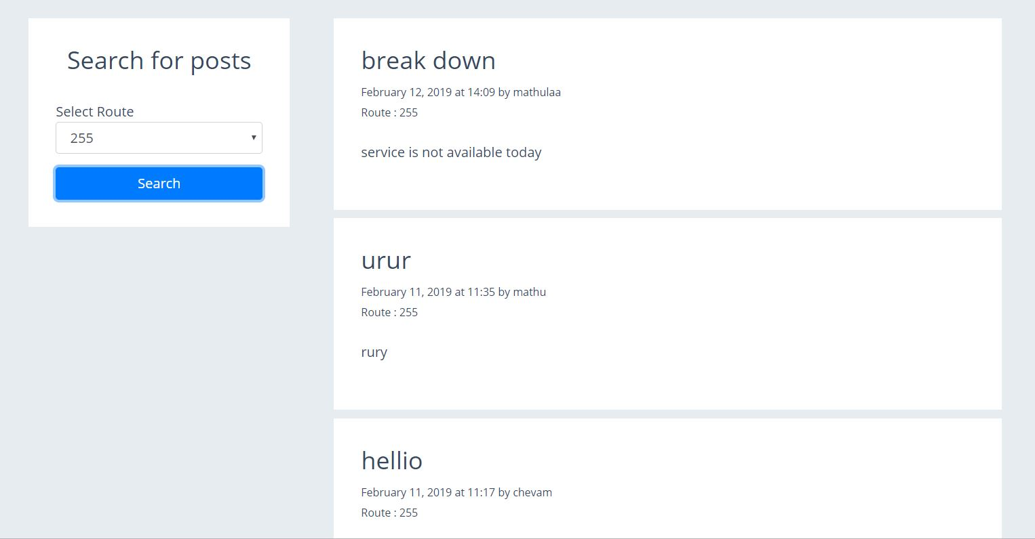

Slide 18
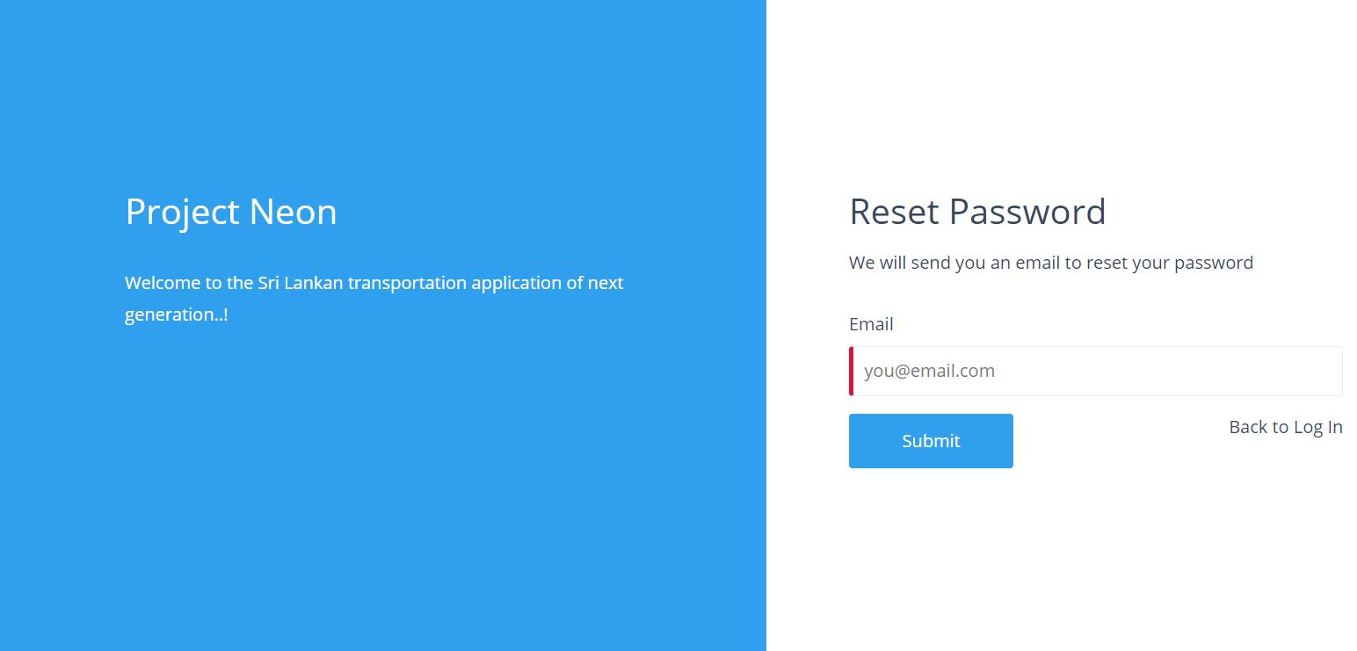

Slide 19
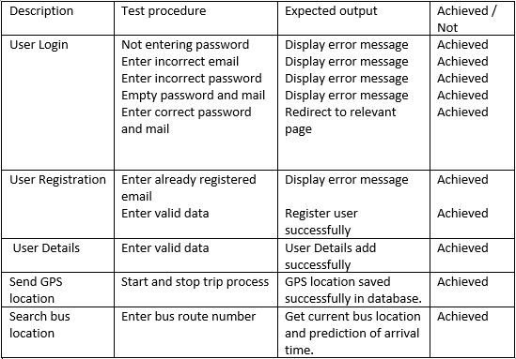
Evaluation

Slide 20
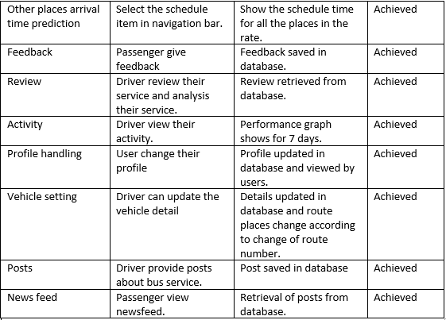

Slide 21
Conclusion
Achieved Objectives
Provide system for all the users to choose their role as either driver or passenger
Allow the users to update their profile.
Allow the drivers to update their vehicle details.
Developed the system to track the current location of the driver and the passenger.

Slide 22
Prediction of arrival time for a particular bus .
Scheduled time for places of destinations.
Driver rating system was successfully deployed.
Performance graph for drivers successfully created.
Drivers posting system successfully generated

Slide 23
Further Works
Provide arrival time prediction for many buses at a time
Use a server to automatically run the python script to display the performance graph
Use Registration of a user as driver and passenger
Use NB-IoT(Narrow Band –Internet of Things) for sending the GPS location

Slide 24
THANK YOU

